Slide 1
RESTORATIVE PRACTICES
Developed by Sacramento City Unified School District Downloaded from CASEL’s District Resource Center
Cohesion Schools
June 22nd, 2016
Notes:
**Change to 6/22/16

Slide 2
Introduction Circle
What’s your name?
Where do you work?
Where is your favorite vacation spot?
Developed by Sacramento City Unified School District Downloaded from CASEL’s District Resource Center
Notes:
8:45-9:00

Slide 3
SFUSD Video Reflection
Developed by Sacramento City Unified School District Downloaded from CASEL’s District Resource Center
Introduction to Restorative Practices
THINK: What question or challenge came to mind in terms of expanding restorative practices for yourself or at your site?
Pair up with a neighbor and discuss.
Notes:
Rosie will do….

Slide 4
Social Discipline Window
Developed by Sacramento City Unified School District Downloaded from CASEL’s District Resource Center
Control
Support

Slide 5
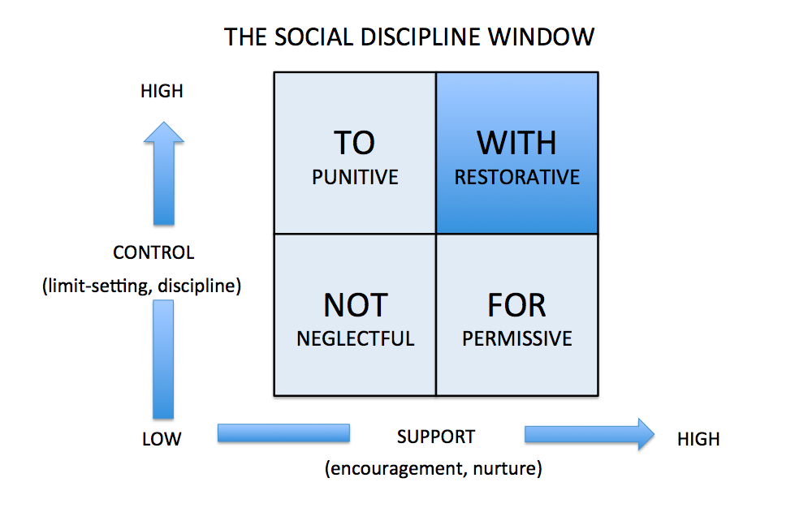
Developed by Sacramento City Unified School District Downloaded from CASEL’s District Resource Center

Slide 6
Social Discipline Window Activity
Developed by Sacramento City Unified School District Downloaded from CASEL’s District Resource Center
In small groups of 3 or 4:
• Talk about a time when someone in a position of authority treated you restoratively
• What was that experience like for you?
• What was it specifically that made it restorative?
• What can YOU do to be more purposeful in
your practice?

Slide 7
Practitioner Styles
Developed by Sacramento City Unified School District Downloaded from CASEL’s District Resource Center
» In which box would you be operating if you said each of the following to a student/young person:
» Sit down and shut up.
» You really only have to do it if you want to.
» I don’t care what you do, sort it out yourself.
» You are aware of the expectations in this class. How can
I support you in reaching them?

Slide 8
Practitioner Styles Activity
Developed by Sacramento City Unified School District Downloaded from CASEL’s District Resource Center
In your groups, identify the behaviors you would likely observe if a practitioner’s style was predominately:
⇛Punitive
⇛Permissive
⇛ Neglectful
⇛Restorative
What would the likely OUTCOMES be for a young person?

Slide 9
Punitive Practitioner Style
Developed by Sacramento City Unified School District Downloaded from CASEL’s District Resource Center
Low Support/High Control
⇛Punitive and often uses loud, angry voice
⇛ Notices inappropriate behavior more than appropriate
⇛ Has high standards
Likely Outcomes
⇛Ordered classroom/setting
⇛Anxious resentful students
⇛Short term compliance but rarely lasting behavior change
⇛High Teacher/practitioner stress
⇛Negative classroom atmosphere

Slide 10
Practitioner Styles Activity
Developed by Sacramento City Unified School District Downloaded from CASEL’s District Resource Center
In your groups, identify the behaviors you would likely observe if a practitioner’s style was predominately:
⇛Punitive
⇛Permissive
⇛ Neglectful
⇛Restorative
What would the likely OUTCOMES be for a young person?

Slide 11
Permissive Practitioner Style
Developed by Sacramento City Unified School District Downloaded from CASEL’s District Resource Center
High Support/Low Control
⇛Warm and supportive
⇛ Doesn’t set limits
⇛ Focus on effort and de-emphasis of quality
⇛Inappropriate behavior handled through ignoring or handled with weak reprimands or pleading
Likely Outcomes
⇛Students feel liked and supported
⇛Chaotic out of control classroom
⇛Students do not feel secure in the teacher’s capacity to “manage”
⇛Poor work quality
⇛Students feel anxious/uncertain
⇛High teacher stress

Slide 12
Neglectful Practitioner Style
Developed by Sacramento City Unified School District Downloaded from CASEL’s District Resource Center
Low Support/Low Control
⇛Teacher remains at desk and students do not feel cared for
⇛Teacher does not appear concerned about quality of students’ work
⇛ May result from teacher stress, burn-out, depression or physical illness
⇛May be lack of skill in how to be warm while demanding
Likely Outcomes
⇛May miss warning signs of academic or behavioral difficulties in students
⇛Students may withdraw and feel worthless
⇛Increased acting out in order to get teacher’s attention or because no sense or order or control in classroom
⇛Limited meaningful learning taking place

Slide 13
Restorative Practitioner Style
Developed by Sacramento City Unified School District Downloaded from CASEL’s District Resource Center
High Support/High Control
⇛Positive kind and supportive relationships
⇛Effective discipline plan and orderly classroom
⇛ Sense of hope/optimism
⇛Students feel sense of safety and competence
⇛High level of work quality
⇛High job satisfaction
Likely Outcomes
⇛Positive atmosphere
⇛High Quality work output
⇛Positive Relationships

Slide 14
Break!
Please be back by
11:00.
Developed by Sacramento City Unified School District Downloaded from CASEL’s District Resource Center

Slide 15
Fair Process: The Central Idea
Developed by Sacramento City Unified School District Downloaded from CASEL’s District Resource Center
“...individuals are most likely to trust and cooperate freely with systems - whether they themselves win or lose by those systems - when fair process is observed.”
(W. Chan Kim & Renee Mauborgne, Harvard Business Review, January 2003)

Slide 16
The Three Principles of Fair Process
Developed by Sacramento City Unified School District Downloaded from CASEL’s District Resource Center
⇛Engagement
⇛Explanation
⇛Expectation Clarity
(W. Chan Kim & Renee Mauborgne, Harvard Business Review, January 2003)

Slide 17
What Fair Process Isn’t
Developed by Sacramento City Unified School District Downloaded from CASEL’s District Resource Center
⇛Decisions by consensus
⇛Democracy in your system
⇛Does not set out to win people’s support through compromises that accommodate every individual’s opinions, needs, or interest
⇛Leaders forfeiting their responsibility to make decisions, establish policies and procedures

Slide 18
What Fair Process Achieves
Developed by Sacramento City Unified School District Downloaded from CASEL’s District Resource Center
⇛Fair process builds trust and commitment, which
⇛Produces voluntary co-operation, which
⇛Drives performance, which
⇛Leads individuals to go beyond the call of duty
⇛Through sharing their knowledge, experiences and creativity

Slide 19

Compass of Shame
Developed by Sacramento City Unified School District Downloaded from CASEL’s District Resource Center
WITHDRAWAL
Isolating oneself
Running & hiding
ATTACK OTHERS
Turning the tables
Blaming the victim
Lashing out verbally or physically
ATTACK SELF
Self put down
Masochism
AVOIDANCE
Denial
Abusing drugs & alcohol
Distraction through thrill seeking

Slide 20
Shame Activity
Developed by Sacramento City Unified School District Downloaded from CASEL’s District Resource Center
In triads share which pole on the compass of
shame you are drawn to when you experience a
shame moment.
You do not have to share the story.

Slide 21
You can respond to others experiencing shame by:
Developed by Sacramento City Unified School District Downloaded from CASEL’s District Resource Center
⇛Listening to what they have to say.
⇛Being present with them, without trying to problem solve.
⇛Reflecting on what has caused the shame.
⇛Acknowledging their feelings.
⇛Encouraging them to talk about their experience.

Slide 22
John Braithwaite’s Hypothesis
Developed by Sacramento City Unified School District Downloaded from CASEL’s District Resource Center
Separating the ‘deed from the doer’
Restorative Practices allow:
The act (unacceptable behavior) to be rejected because they failed to meet expectations or standards.
While:
Acknowledging the intrinsic worth
of the person and their potential
contribution to society.

Slide 23
Stigmatizing vs. Reintegrative Shame
Developed by Sacramento City Unified School District Downloaded from CASEL’s District Resource Center
Stigmatizing
Pushes the offender out of the community and labels them. The offender is now a bad person who committed a crime or harm. This label may follow them their whole lives. Since the offender is pushed out of the community it may encourage their participation in further harmful behaviors.
Source: John Braithwaite, Crime, Shame and Reintegration
Reintegrative Shame
Expresses disapproval but does not push the offender out of the community. This type of shame rejects the act but not the person and allows for the person to be reintegrated back into the community.

Slide 24
Lunch
Please Be Back By 12:30!
Be Prompt!!
Developed by Sacramento City Unified School District Downloaded from CASEL’s District Resource Center

Slide 25
Energizer...
Developed by Sacramento City Unified School District Downloaded from CASEL’s District Resource Center

Slide 26

Restorative Practices Continuum
Developed by Sacramento City Unified School District Downloaded from CASEL’s District Resource Center

Slide 27
Affective Statements:
are feeling statements about the impact of another person’s behavior on us; they describe how WE feel in relation to another’s behavior.
Developed by Sacramento City Unified School District Downloaded from CASEL’s District Resource Center
⇛ Set Boundaries
⇛ Provide Feedback
⇛ Teach Empathy

Slide 28
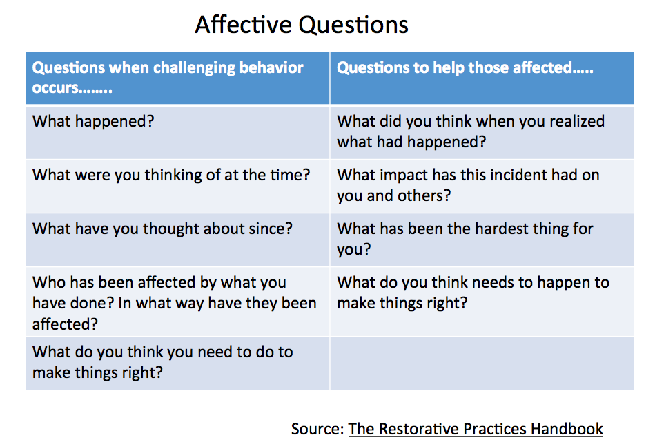
Developed by Sacramento City Unified School District Downloaded from CASEL’s District Resource Center

Slide 29
Affective Statements: Activity One
Developed by Sacramento City Unified School District Downloaded from CASEL’s District Resource Center
Complete the following statements:
⇛ I feel glad when...
⇛ I feel mad when...
⇛ I feel sad when...
⇛ I feel scared when...
⇛ I feel...when...

Slide 30
Typical Responses Affective Statements
Developed by Sacramento City Unified School District Downloaded from CASEL’s District Resource Center
Stop teasing Ruben.
Talking during class is inappropriate.
You shouldn’t do that.
Sit down and be quiet.
You need to quit fighting with him.
Source: Restorative Practices Handbook
It makes me uncomfortable when I hear you teasing Ruben.
I am frustrated that you aren’t listening to me.
I feel sad when you say something like that to Juan.
I get angry when you talk and joke during my lessons.
I was shocked to see you hurt Neveah.

Slide 31
Affective Statements: Activity Two
Developed by Sacramento City Unified School District Downloaded from CASEL’s District Resource Center
Change each statement into an affective statement:
⇛ Talking while I’m talking is rude.
⇛ For the third time, put away the phone.
⇛ Sit down and stop talking.
⇛ Why don’t you ever do your homework?
⇛ You need to start getting along with others.
⇛Pick your head up.

Slide 32
Check in!
Developed by Sacramento City Unified School District Downloaded from CASEL’s District Resource Center
Think/Pair/Share with your partner:
Why affective statements? What are the benefits of using affective statements in our classrooms and school communities?

Slide 33
Activity: Restorative Questions - Side Two
Developed by Sacramento City Unified School District Downloaded from CASEL’s District Resource Center
Think about a time in your life when you were harmed.
⇛ What did you think when you realized what had happened?
⇛ What impact has this incident had on you and others?
⇛ What has been the hardest thing for you?
⇛ What do you think needs to happen to make things right?

Slide 34
Activity: Restorative Questions - Side One
Developed by Sacramento City Unified School District Downloaded from CASEL’s District Resource Center
Think about a time in your life when you harmed someone.
⇛ What happened?
⇛ What were you thinking at the time?
⇛ What have you thought about since?
⇛ Who has been affected by what you have done and in what way?
⇛ What do you think you need to do to make things right?

Slide 35
Break!
Be back in 10 minutes!
Developed by Sacramento City Unified School District Downloaded from CASEL’s District Resource Center

Slide 36
Energizer Circle
Developed by Sacramento City Unified School District Downloaded from CASEL’s District Resource Center

Slide 37
Why Circles?
Developed by Sacramento City Unified School District Downloaded from CASEL’s District Resource Center
Equality-everyone literally has equal seating.
Safety and trust-you can see everyone in the circle.
Responsibility and Ownership-everyone plays a role.
Teacher as member; reminds you to facilitate-rather than lecture.
Builds connections-everyone hears everyone else’s response.

Slide 38
Circles
Developed by Sacramento City Unified School District Downloaded from CASEL’s District Resource Center
Sequential
Typically specific questions answered in order around the circle.
Talking Piece for added structure.
Participation expected, but not always required. (May Pass)
Non-Sequential
May feel less controlled, but have benefits in many situations.
They can be: highly structured, loosely structured, or unstructured.
There is no particular order of speaking.
Expectations for participation are more relaxed.

Slide 39
Secrets to Success
Developed by Sacramento City Unified School District Downloaded from CASEL’s District Resource Center
Clear topic and goal
Set a positive tone
Keep the focus
Get some allies
MAKE SURE participants understand why you are doing circles (explanation and expectation clarity), remembering it may be uncomfortable for them at first.

Slide 40
Introducing the Concept
Developed by Sacramento City Unified School District Downloaded from CASEL’s District Resource Center
» Explain reasoning/rationale
» Be upbeat
» Regard resistance as fear

Slide 41
Circle Scenarios
Developed by Sacramento City Unified School District Downloaded from CASEL’s District Resource Center
In the Classroom:
End of Quarter/Grading period
Goal Setting
Vandalism/Theft
In response to violence or tragedy
Field trip
Excessive Tardies
Staff or community:
Team Building
Staff Development
Problem Solving
Getting parents involved in community
Truancy

Slide 42
Circle Scenarios Activity
Developed by Sacramento City Unified School District Downloaded from CASEL’s District Resource Center
The facilitator will run a sequential go-around.
Facilitator will guide the group into choosing 2-3 specific scenarios.
After the scenarios are chosen, the group will have a non sequential discussion:
How would you use circles to address this scenario?
What kind of circle would you use?
What questions would you ask to address the issue?
Build the questions using the affective questions format of past, present, and future.
Facilitator leads the discussion.

Slide 43
Closing Circle
Developed by Sacramento City Unified School District Downloaded from CASEL’s District Resource Center
Notes:
3:10-3:15

