Slide 1

Welcome to the 2015-16 School Year!
Developed by Washoe County School District Downloaded from CASEL’s District Resource Center

Slide 2
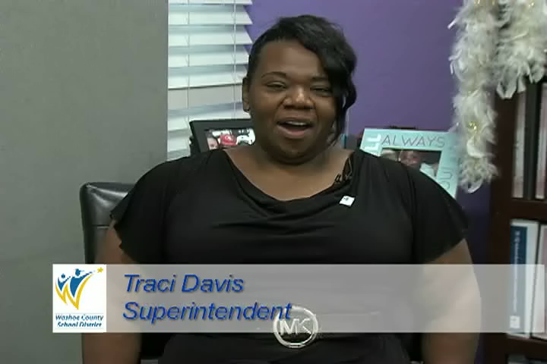
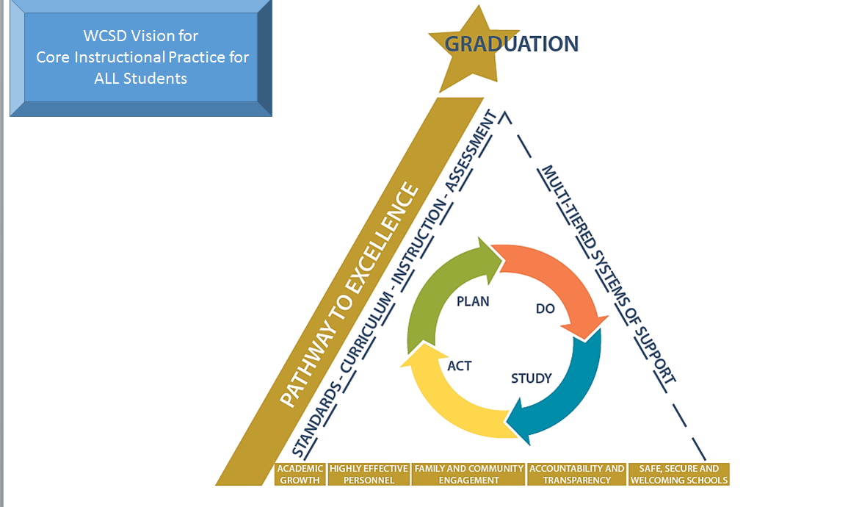
Superintendent Traci Davis
Notes:
Talk about the features in the Teaching and Learning Framework graphic (with which most should be familiar).
Play the Superintendent’s video.
Reiterate how positive it is to have a District Vision for Core Instructional Practice for ALL students.

Slide 3
Outcomes (for administrators on 8/3)
Become familiar with the Four Fundamentals of the WCSD Vision for Core Instructional Practice
Build capacity and confidence necessary to lead staff discussion; walk away with the materials to facilitate session
Notes:
This is for school leaders. The next slide is for teachers.

Slide 4
Outcomes (for teachers 8/4-6)
Become familiar with the Four Fundamentals of the
WCSD Vision for Core Instructional Practice
Engage in dialogue regarding evidence of strengths and opportunities for growth with regard to expectations
Prioritize the Four Fundamentals to determine area of focus for the year
Notes:
This is the outcome slide for teachers and staff. Use it with them.

Slide 5
Learning Activity #1: Sort
Sort pink position and expectation statements under each of the Four Fundamentals; justify your placements
Negotiate moves as appropriate
Listen to WCSD students share the expectations
Notes:
This is a sort activity.
Group participants into teams of 4-6.
Follow the directions on the slide.
Participants will sort the pink position and expectation statements under each of the fundamentals.
Remind participants that there will be overlap and that the goal is not so much to get it “right” but rather, to engage in rich dialogue.
Optional Hint: Tell participants that there is one Position Statement under each Fundamental. There are 4 expectation statements under Fundamental I and 7 under each of the others.
Play the next four slides so teachers can compare their sort with the District document.

Slide 6

Fundamental I: Core Curriculum and Instruction
Position Statement: All students are provided Tier I core instruction as aligned to the Nevada Academic Content Standards (NVACS).
Expectations:
  The Core Actions are evident in planning throughout the PLC process and observable in instruction. Schools use primary and supplementary curricular materials, horizontally and vertically articulated, and documented.
  ALL intervention time is scheduled outside Tier I core instruction periods.
  Students receiving intervention are provided equitable access/opportunities for non-core and elective instruction.
  School leaders monitor and support the improvement of culturally responsive instructional practices of teachers to ensure student success.
Press Play
Notes:
Please press the PLAY button to hear student voices.

Slide 7
Fundamental II: Inclusive Practice
Position Statement: Through collaboration among general education, special education, and ELL staff, ALL students will be provided Tier I core instruction in the general education classroom environment.
Expectations:
  ALL instructional staff embrace and demonstrate ownership for ALL students.
  All resource teachers (special education, ELL, GATE, etc.) are included in PLCs and unit/lesson planning.
  All students are held to grade level expectations and beyond.
  Scaffolding is a key component of differentiated classrooms.
  All staff participate in professional learning to develop crucial cultural competency to enhance understandings and practices with diverse students and families.
  Time is reserved in each teacher’s schedule for collaborative planning that enhances inclusive practice.
  Student centered scheduling is in place and monitored.
Press Play
Notes:
Please press the PLAY button to hear student voices.

Slide 8
Fundamental III: Climate and Engagement
Position Statement: School staff use relevant student behavior and school climate data when making decisions within the continuum of service.
Expectations:
  Positive relationships are built with ALL students.
  Knowledge of student backgrounds and interests drives positive engagement strategies and relevance of class work and homework assignments.
  Within the PLC structure, teachers will explore the associations between behavioral indicators and academic achievement.
  Reinforcing positive behavior is exhausted before the use of office referrals and other disciplinary strategies that limit access to instruction.
  Schools implement PBIS and SEL framework, and monitor effectiveness through MTSS process.
  Schools track and monitor student behavior data through IC.
  Teachers intentionally work toward developing common cultural connections around language for more effective instructional and learning opportunities in and outside of the classroom.
Press Play
Notes:
Please press the PLAY button to hear student voices.

Slide 9
Fundamental IV: Multi-Tiered System of Support
Position Statement: ALL students are provided Tier I core instruction in the general education classroom environment and their individual needs are addressed through collaboration between general education staff, special education staff, and ELL staff.
Expectations:
  The MTSS process aligns with PLCs and school leadership team functions.
  The ICEL model is used in the MTSS referral process: instruction, curriculum, and learning environment are ruled out as “causal” factors before attributions to learners requiring interventions are made.
  Local and district level measures are used to monitor student responsiveness to core instructional practice and response to intervention as necessary.
  Multiple sources of data are used to monitor student progress and to determine the effectiveness of instruction and interventions.
  Functioning PLCs and MTSS teams meet on a regular basis to review student outcomes and determine needed supports.
  Documentation of student interventions and outcomes are maintained in the MTSS tab of IC.
  A special education referral is only considered after interventions at all tiers have been implemented with fidelity and student outcomes are insufficient. (MTSS is the evaluation strategy for determining specific learning disability.)
Press Play
Notes:
Please press the PLAY button to hear student voices.

Slide 10
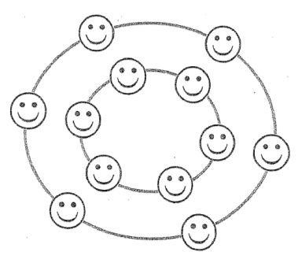
Learning Activity #2: Inside-Outside Circle
If your birthday is in an odd-numbered month, please form the inside circle and face out.
If your birthday is in an even-numbered month, please form the outside circle and face in.
If you can’t recall your birthday, fill in the remaining spots ☺
Notes:
This is an Inside-Outside Circle activity.
Half of the participants stand up and form a circle with their backs to the inside of the circle. They are partner A. The other half of the participants form a circle facing a partner from the first circle. These participants are partner B. Partner A will speak first, quickly addressing one of the discussion stems. This takes about a minute. Then partner B speaks for the same length of time, adding to the summary.
Now it is time to move. Have the participants who are partner A raise their right hands and then move two people to the right/left to meet with a new partner. Partner B speaks first to address stem 2. Repeat for the next several discussion stems. You get to decide how many moves the circles make. You can have the inside or outside circle move – just be specific.
If space does not allow for Inside-Outside Circle, use another strategy of your choice allow participants to talk with different colleagues.

Slide 11
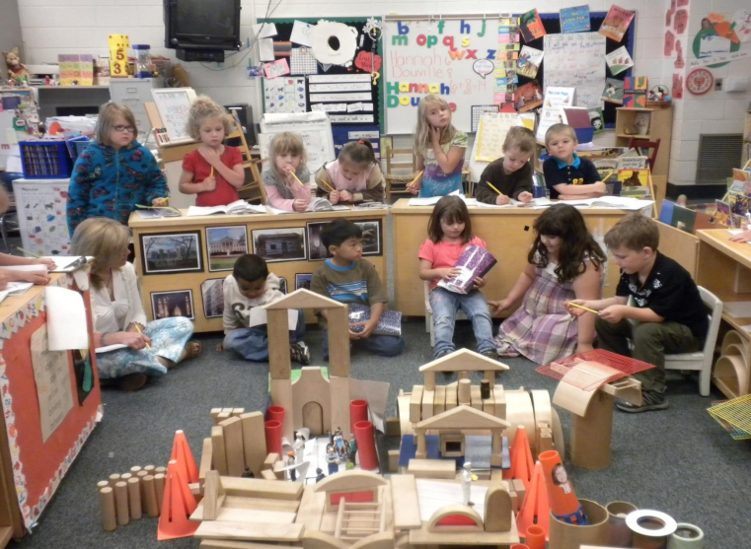
Fundamental I: Curriculum and Instruction
Discussion Stem - What instructional strategies do we use regularly that engage students and ensure high expectations?
Notes:
Based on time, use as many as the discussion stems as desired throughout the remainder of the activity. You may also insert a question of your choice here.
Other Possible Discussion Stems (optional):
What evidence or examples show ALL students are participating in tier I, core instruction in the general education environment (i.e. students are not pulled out of Tier I to receive intervention)?
What evidence or examples show that teachers engage students in their learning through instructional strategies that ensure achievement of learning through relevancy, relationships and high expectations for ALL students?
What are our primary and supplementary curricular materials?
How are our curricular materials articulated and documented?
What evidence do/will we collect to monitor the, relevance and effectiveness of our curricular materials?
What evidence do we have that students receiving intervention are also receiving elective/enrichment instruction?
What evidence do we have to show Tier I core instruction is monitored for effectiveness to ensure 80% of ALL students are learning?

Slide 12
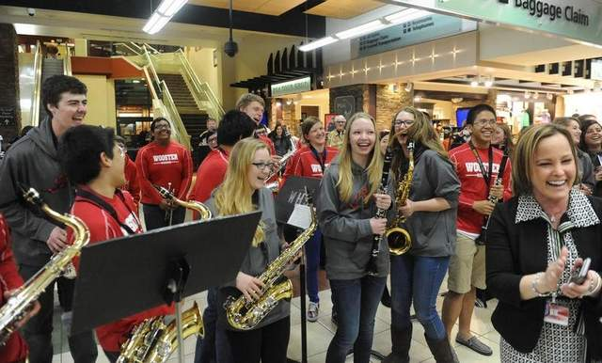
Fundamental II: Inclusive Practice
Discussion Stems
What are the ways in which co-planning and co-teaching take place in our building?
What does inclusive practice look like in our building?
Notes:
Based on time, use as many as the discussion stems as desired throughout the remainder of the activity. You may also insert a question of your choice here.
Other Possible Discussion Stems (optional):
What evidence or examples show how the full instructional staff is involved in co-planning and co-teaching for students of any background (e.g. students with IEPs, ELL, GATE, students from a variety of cultures)?
What evidence or examples show how inclusive practice fits in and supports our site’s MTSS process?
What evidence or examples show how professional learning is provided for all staff to support inclusive practice?
What evidence or examples show how student centered scheduling is in place and monitored?

Slide 13
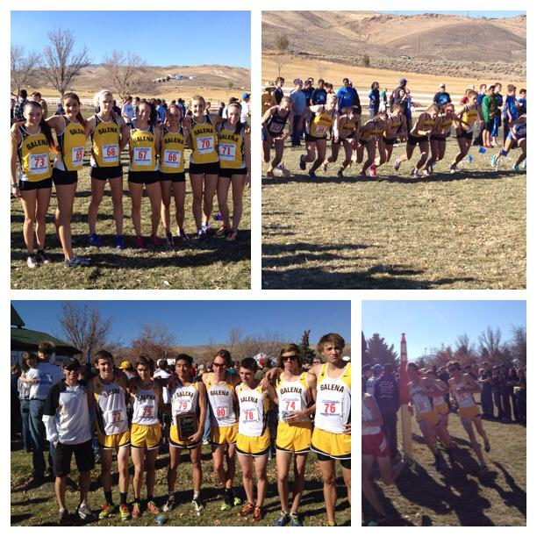
Fundamental III: Climate & Engagement
Discussion Stems
To what extent are Social Emotional Learning strategies incorporated into daily instructional practice?
What clear, consistent classroom and school wide behavioral expectations for our students do we teach regularly?
Notes:
Based on time, use as many as the discussion stems as desired throughout the remainder of the activity. You may also insert a question of your choice here.
Other Possible Discussion Stems (optional):
What evidence or examples show student behaviors (discipline, attendance, relationships, engagement) are part of the MTSS framework and part of the IAT dialogue?
How do we monitor our behavior system and interventions for effectiveness at all tiers?
What clear, consistent classroom and school-wide behavioral expectations for our students do we teach regularly? When do we teach them?
Have we reflected on our own beliefs about diverse students and their backgrounds?
How do we review school-wide student behavior data with staff to make decisions about PBIS and teaching behavioral expectations?
What systems do we have in place to review climate survey data with staff, students, and families? How are these systems used to create change?
What evidence or examples show how Social and Emotional Learning strategies are incorporated into our daily instruction?

Slide 14
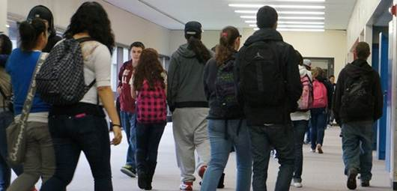
Fundamental IV: MTSS
Discussion Stems
How are PLC structures and discussions leading to more effective MTSS outcomes?
What are the ways in which PLCs incorporate discussions regarding student academic and behavioral progress?
Notes:
Based on time, use as many as the discussion stems as desired throughout the remainder of the activity. You may also insert a question of your choice here.
Other Possible Discussion Stems (optional):
How frequently do school PLCs and IAT meet for data-based problem solving (i.e., review student progress & make changes to instruction/supports?) Who are the IAT members? Do PLCs engage in problem solving for Tiers I and II?
How are PLCs and IATs consistently reviewing both academic and behavioral (discipline, attendance, beliefs and expectations, relationships, engagement) progress together?
What data are used to support data based problem solving in the MTSS framework?
How do we determine the effectiveness of both academic and behavioral interventions?

Slide 15
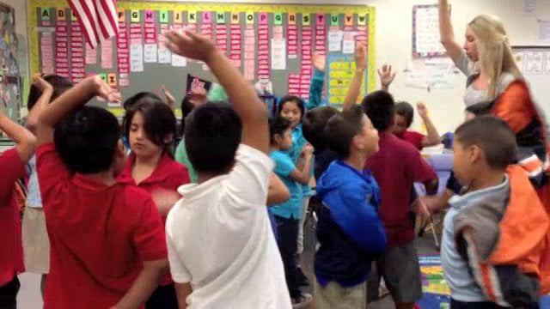
Reflecting on the Four Fundamentals and discussion stems, if you had to choose one to focus on for the year, which one would you select and why?
Notes:
This step is critical.
After participants share their reflections, ask a few to share their thinking with the whole group.
Let them know that they will move into the four corners activity next, where they’ll have the opportunity to explore the Four Fundamentals in more detail.

Slide 16
Learning Activity #3: Four Corners
Assemble in groups of 4-8 at each Fundamental poster
Discuss position and expectation statements in more depth
Use sticky notes to record areas of strength and opportunities for growth
Repeat at all Four Corners, adding stars to sticky notes you support along the way
The last group summarizes and shares for school poster
Notes:
Have participants follow the directions on this slide.
Remind them to reflect on and relate SPP goals as they dive deep into this discussion.
When you do this activity with your staff, they need to rotate through all four posters.
The last group at each poster summarizes the Areas of Strength and Opportunities for Growth into 3-5 bullets.

Slide 17

School Poster
2. Prioritize area of focus and determine needed supports
1. After visiting all Four Corners, as a whole staff, list a few strengths and opportunities for growth
4. Hang poster in prominent location at school
3. Transfer poster information to electronic version and email to
Area Superintendent
and Aly Kendrick
Notes:
After participants have visited all four corners and summarized, come back together as a whole group and follow the directions above.
After discussing all Four Fundamentals as a staff, determine which one will be your focus for the year by prioritizing them in order in the 3rd column of the chart (i.e., 1,2,3,4). Your identified priority will drive:
Principal / Assistant Principal professional learning track at LTL meetings
IS professional learning track at Blue Fridays
Teacher professional learning content on Pink Wednesdays
Strategies for determining priority may include:
Small group share leading to whole group consensus
Complete first two columns as a whole staff, then meet with your leadership team to finalize decision
Other strategies at principal’s discretion
List supports needed for Growth Opportunities.
Transfer information into electronic version of poster and email to Area Superintendent and Aly Kendrick NO LATER THAN FRIDAY, AUGUST 14.
Hang the poster in a prominent location at your school site. Re-visit mid year and end of year to reflect on growth.

Slide 18
Did we meet our outcomes?
(for administrators on 8/3)
Become familiar with the Four Fundamentals of the WCSD Vision for Core Instructional Practice
Build capacity and confidence necessary to lead staff discussion; walk away with the materials to facilitate session
Notes:
This is for school leaders. The next slide is for teachers.

Slide 19
Did we meet our outcomes?
(for teachers 8/4-6)
Become familiar with the Four Fundamentals of the
WCSD Vision for Core Instructional Practice
Engage in dialogue regarding evidence of strengths and opportunities for growth with regard to expectations
Prioritize the Four Fundamentals to determine area of focus for the year
Notes:
This is the outcome slide for teachers and staff.

Slide 20


Be sure to pick up supplies before you leave!
Notes:
This slide is for administrators only.

