Slide 1
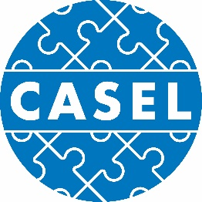
The Case for Social and Emotional Learning:
Powerpoint template
Notes:
These slides are divided into 3 basic parts that are easy to customize and/or localize.
Slides 2-5: What is SEL
Slides 6-12:. the scientific evidence that documents SEL’s benefits.
Slides 13-21: surveys that document the growing demand for SEL from all sectors.
Slide 23: Resources that can help you

Slide 2
WHAT IS SOCIAL AND EMOTIONAL
LEARNING (SEL)?

Slide 3
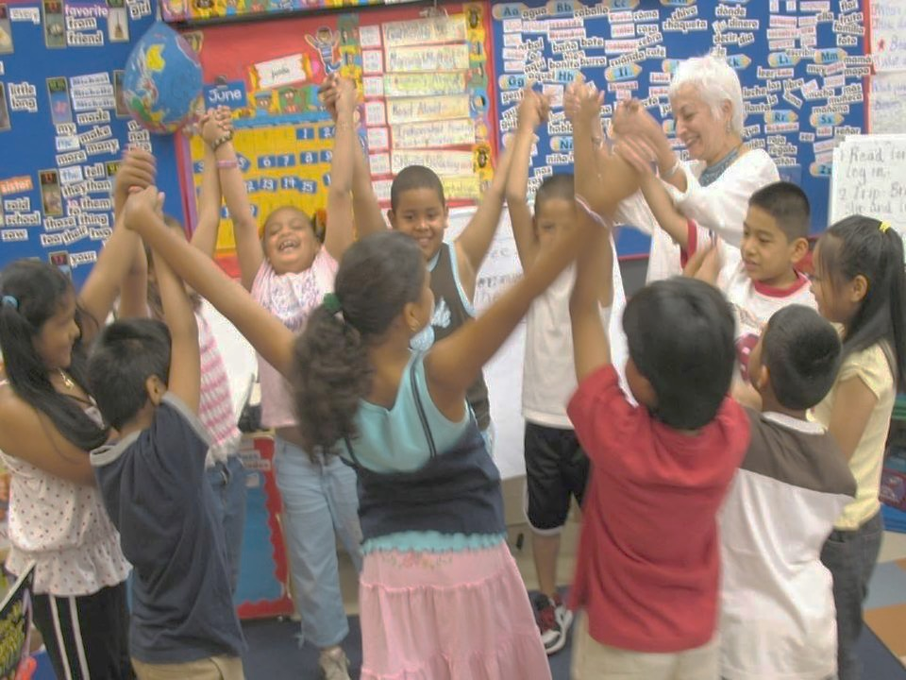
SEL is…
The process through which children and adults acquire and effectively apply the knowledge, attitudes, and skills necessary to understand and manage emotions, set and achieve positive goals, feel and show empathy for others, establish and maintain positive relationships, and make responsible decisions.

Slide 4
Social and Emotional Learning
SEL
Impulse control
Stress management
Self-discipline
Self-motivation
Perseverance
Goal-setting
Organizational skills
Identifying emotions
Self-perception/Identity
Recognizing strengths
Sense of self-confidence
Self-efficacy
SELF-AWARENESS
SELF-MANAGEMENT
Perspective-taking
Empathy
Appreciating diversity
Respect for others
Social and
Emotional
Learning
(SEL)
SOCIAL AWARENESS
RESPONSIBLE DECISION-MAKING
RELATIONSHIP SKILLS
Identifying problems
Analyzing situations
Solving problems
Evaluating
Reflecting
Ethical responsibility
Communication
Social engagement
Building relationships
Working cooperatively
Resolving conflicts
Helping/Seeking help
Notes:
How we understand ourselves, how do we work well with others, and how do we make good decisions
So everything from resilience, managing anger, how you deal with conflict, how you deal with others – is what underlies everything. And we know if you are intentional

Slide 5
What does SEL look like in a
classroom, school, community?
FAMILY & COMMUNITY PARTNERSHIPS
HOMES & COMMUNITIES
SEL CURRICULUM & INSTRUCTION
SCHOOLS
CLASSROOM
SELF-AWARENESS
SELF-MANAGEMENT
Social and
Emotional
Learning
(SEL)
SOCIAL AWARENESS
RESPONSIBLE DECISION-MAKING
SEL CURRICULUM & INSTRUCTION
RELATIONSHIP SKILLS
SCHOOLWIDE PRACTICES & POLICIES
Notes:
Systemic SEL is promoted across multiple contexts every day. SEL is more than just a program or lesson. It is about how teaching and learning happens, as well as what you teach and where you learn. CASEL’s widely used framework identifies five core competencies that when prioritized across settings – districts, schools, classrooms, families, and the wider community – can educate hearts, inspire minds, and help students navigate the world more effectively.

Slide 6


SEL works:
Compelling national evidence
Science Links SEL to Student Gains:
Better social-emotional skills
Improved attitudes about self, others, and school
Positive classroom behavior
11 percentile-point gain on standardized achievement tests
Fewer conduct problems
Less emotional stress
Lower drug use
…and adults benefit too
Teachers who possess social and emotional competencies are more likely to stay in the classroom longer because they’re able to work more effectively with challenging students —one of the main causes of burnout.
Statistically significant associations between measured social-emotional skills in kindergarten and key young adult outcomes across multiple domains of education, employment, criminal activity, substance use, and mental health.
Notes:
6
6
An overview slide for those who want only one slide, with research highlights.
It combines findings from several studies on one slide. Note that the citations are not on the actual slide, but they are here in case you are asked:
Meta-analysis source (top section): Durlak, J.A., Weissberg, R.P., Dymnicki, A.B., Taylor, R.D., & Schellinger, K. (2011). The impact of enhancing students’ social and emotional learning: A meta-analysis of school-based universal interventions. Child Development: 82 (1), 405-432.
Teacher burnout (bottom left): Jennings, P.A. & Greenberg, M.T. (2009). The prosocial classroom: Teacher social and emotional competence in relation to student and classroom outcomes. American Educational Research Association.
Adult outcomes (bottom right): Jones, D.E., Greenberg, M., & Crowley, M. (2015) Early social-emotional functioning and public health: The relationship between kindergarten social competence and future wellness. American Journal of Public Health 105 (11), 2283-2290.

Slide 7
Science Links SEL to Student Gains:
Landmark study documented multiple benefits of SEL
2011 meta-analysis of 213 studies involving school-based, universal SEL programs including over 270,000 students in K-12 revealed:
  Science Links SEL
  to Student Gains:
    Social-emotional skills
    Improved attitudes about self, others, and school
    Positive classroom behavior
    11 percentile-point gain on standardized achievement tests
Reduced Risks
for Failure:
    Conduct problems
    Emotional distress
Source: Durlak, J.A., Weissberg, R.P., Dymnicki, A.B., Taylor, R.D., & Schellinger, K. (2011) The impact of enhancing students’ social and emotional learning: A meta-analysis of school-based universal interventions. Child Development: 82 (1), 405-432.
Notes:
7
7
This is a great slide on the most cited and compelling research on SEL, the 2011 meta-analysis. Findings from this are incorporated into the previous slide, but if you have time to spend on just this, it’s a great slide.
Specifically, you can talk about each of the bullets as their own compelling piece of evidence. Depending on your audience, you may want to emphasize certain points. For example:
Not only did we learn from this meta-analysis that SEL programming leads to improvements in SEL skills, we also see some other important outcomes:
Improved attitudes about self, others, and school (extremely important and cited by educators as one of the main reasons they value SEL, so it’s good to emphasize this if audience is school-based folks).
Positive classroom behavior (this is important, but be careful not to over emphasize this point for fear that people think SEL is primarily a behavior-management solution, which is a common misperception).
11 percentile point gain on academics: This is a significant data point that warrants emphasis. This kind of improvement on academics is frankly what has gotten the attention of so many. This data point can foster the transition from a belief that these are “soft skills,” nice-to-haves, to the idea that these are critically important and to be taken seriously.
And don’t forget about the data points in red:
Reductions in conduct problems is an important finding, but once again, it’s important to be wary of folks who think of SEL as behavior management and are looking to “fix broken kids.” See note above.
Reductions in emotional distress warrants significant emphasis. We’re living in a time when emotional distress, depression, anxiety, and suicide are at an all-time high. Understanding that SEL can have an impact here is important, but with a word of caution: SEL should not be viewed as a solution for mental illness.

Slide 8
Impact of SEL:
long-lasting and global
A 2017 research study finds that social and emotional learning (SEL) programs benefit children for months and even years.
82
97,000+
Students involved, kindergarten through middle school
Effects assessed
6 mo – 18 yrs
after programs completed
different programs reviewed
(38 outside U.S.)
SEL Students Benefit in Many Areas
HIGHER…
Academic performance
SEL skills
Positive attitudes
Positive social behaviors
LOWER…
Conduct problems
Emotional distress
Drug use
Higher social and emotional competencies among SEL students at the end of the initial intervention was the best predictor of long-term benefits. Benefits were the same regardless of socioeconomic background, students’ race, or school location.
Source: Child Development (July 2017). “Promoting Positive Youth Development Through School-Based Social and Emotional Learning Interventions: A Meta-Analysis of Follow-Up Effects”
Notes:
This slide shows the longitudinal impact of SEL programming. This 2017 meta-analysis included the 82 studies that showed longitudinal affects, and the results show that the gains are LASTING. SEL programming isn’t just a shot in the arm that benefits in the short term. There are long lasting benefits that go beyond school outcomes.
And don’t forget to point out this note at the bottom of the slide:
“Higher social and emotional competencies among SEL students at the end of the initial intervention was the best predictor of long-term benefits. Benefits were the same regardless of socioeconomic background, students’ race, or school location. “

Slide 9

SEL benefits adults:
Positive impact on teachers
Teachers who possess social and emotional competencies are more likely to stay in the classroom longer.
Teachers with high levels of social competence are better able to protect themselves from burnout by:
  developing and managing nurturing relationships with their students
  managing behavior in their classrooms
  serving as behavioral role models for children
  regulating their own emotions,
Source: Jennings, P.A. & Greenberg, M.T. (2009) The Prosocial Classroom: Teacher Social and Emotional Competence in Relation to Student and Classroom Outcomes. American Educational Research Association.
Notes:
This point is also on the summary (slide 2). You may want to emphasize this to highlight the importance of SEL on teacher retention. Needless to say, this is a good one for teachers and principals to see!

Slide 10
SEL works:
Linked to young adult outcomes
Statistically significant associations exist between measured social-emotional skills in kindergarten and young adult outcomes across multiple domains:
Kindergartners who were stronger in SEL competence were more likely to:
  graduate from high school
  complete a college degree
  obtain stable employment in young adulthood
And less likely to be:
  living in public housing
  receiving public assistance
  involved with police
  in a detention facility
Source: Damon E. Jones, Mark Greenberg, and Max Crowley. Early Social-Emotional Functioning and Public Health: The Relationship Between Kindergarten Social Competence and Future Wellness. American Journal of Public Health: November 2015, Vol. 105, No. 11, pp. 2283-2290.
Notes:
This is a great slide to show the power of SEL on predicting future outcomes in school and in life.
Important notes to add include:
This study controlled for demographics (socioeconomic status, race/ethnicity, etc.).
Also may want to add the fact that while the kindergartener’s high or low SEL predicted their adult outcomes, you are not doomed if you don’t have strong SEL in kindergarten! We know from research that SEL is teachable! We can improve SEL and therefore these outcomes if we are intentional and evidence-based in our approach to the work!
This is also a good slide for more politically conservative audiences who like the idea of educational programming that reduces the likelihood of dependency on social programs and public assistance.

Slide 11
SEL works:
Strong return on investment
$
The average return on investment for six
evidence-based programs is
11 to 1
meaning for every dollar invested there is an $11 return, savings from costs not incurred for intervention
Source: Belfield, C., Bowden, B., Klapp, A., Levin, H., Shand, R., & Zander, S. (2015). The Economic Value of Social and Emotional Learning. New York: Center for Benefit-Cost Studies in Education.
Notes:
This is a really important slide for school boards, funders, and anyone who prioritizes or questions the cost benefit analysis of SEL programming. This study out of Columbia University shows that for every dollar invested in SEL programming, you save $11 dollars that would have been spent on costly interventions, remediation, dropout prevention, recovery, etc.

Slide 12
SEL works:
Compelling local evidence
[School/district name] has seen improvements in:
      Data point 1
      Data point 2
      Data point 3
  … and declines in:
      Data point 1
      Data point 2
      Data point 3

Slide 13
public
Most important factor in school quality: teach cooperation, respect, problem solving
PDK Poll, 2017
employers
growth in jobs that require mastery of SEL skills outpaced growth of all other jobs
National Bureau of Economic Research, 2015
Demand is at an all- time high in every sector
district personnel
strong consensus among school/district administrators: SEL skills are important & should be taught in schools to all students
Ready to Lead survey, 2017
principals
95% are committed to developing students’ social and emotional skills in their schools
Ready to Lead survey, 2017
teachers
93% of teachers want a greater focus on social and emotional learning
Missing Piece survey, 2013
parents
3 out of 5 give greater importance to their children being happy & not overly stressed, than doing well in school Learning Heroes Parent Survey, 2017
students
The majority of high school and recent grads agree that going to a school that focuses on developing SEL skills would help better prepare them for life after high school Respected Survey, 2018
Notes:
Overview slide showing growing demand.
Over the last few years, across the country momentum has increased because the research has confirmed our instincts about what is important, and we see all sectors, including parents, employers, principals, teachers, and the STUDENTS THEMSLEVES who are screaming: WE BELIEVE SEL IS CRITICAL.

Slide 14

Employers value SEL
Of surveyed executives say skills such as problem-solving and communicating clearly are equally or more important than technical skills
National Bureau of Economic Research, 2015
92%
The Top 10 skills identified by the World Economic Forum all involve social and emotional competence.
And research shows that social and emotional skills and attitudes also contribute to the other skills such as critical thinking.
Source: Future of Jobs Report, World Economic Forum
Complex problem solving
Critical thinking
Creativity
People management
Coordinating with others
Emotional intelligence
Judgment and decision-making
Service orientation
Negotiation
Cognitive flexibility
Notes:
This slide can be useful for those wanting to know what employers think.

Slide 15
Employers value SEL
7 top characteristics of success at the company are all soft skills, such as communicating and listening well; possessing insights into others; and having empathy.
Priorities: Conflict resolution, leadership, and civic engagement
Wanted: Employees Who Can Shake Hands, Make Small Talk
Bank of America teaches empathy in-house; Subaru pays for soft-skills training (Dec. 10, 2018)
Notes:
For those wanting to know what employers think—part 2

Slide 16
Administrators, Parents, and Teachers value SEL
The overwhelming majority of administrators (96%), teachers (93%) and parents (81%) believe that social and emotional learning is just as
important as academic learning.
Teaching SEL skills in the classroom is most important for improving:
Negative student behaviors such
as bullying
– according to teachers
and administrators
School safety
– according to parents
Source: 2018 Social and Emotional Learning report, 2018
Notes:
More recently, a new report from McGraw Hill was released in 2018 sharing findings from a survey conducted by Morning Consult from September 6-11, 2018.T he findings represent a national sample of 1,140 teachers, administrators and parents.
Overall, administrators, teachers and parents agree: SEL is crucial.

Slide 17
Principals value SEL
Social and emotional skills are teachable in a school setting.
I am very/fairly committed to developing students’ social and emotional skills in my school.
Definitely teachable 74%
Probably teachable 25%
99%
Very committed 69%
Fairly committed 26%
95%
believe students from all types of background would benefit from SEL
73%
Source: Ready to Lead, 2017
Notes:
For those wanting to know what principals think

Slide 18

Parents value SEL
3 out 5
parents
say “being happy/not overly stressed”
is more important than academics.
*Note the research says this is a false choice: social and emotional well-being contributes to academic success, among other benefits.
58%
58%
57%
54%
51%
50%
50%
Source: Learning Heroes, 2017
Notes:
For those wanting to know what parents think

Slide 19
Teachers value SEL
In 2013, we learned that:
93%
want a greater focus on SEL in schools
Teachers cite positive effects on:
Workforce readiness
Life success
Attendance/graduation
College preparation
Academic success
87%
87%
80%
78%
75%
More recently:
74%
Report that they are devoting more time to teaching SEL skills today compared to five years ago.
Source: The Missing Piece, 2013
Source: 2018 Social and Emotional Learning report, 2018
Notes:
For those wanting to know what teachers think

Slide 20
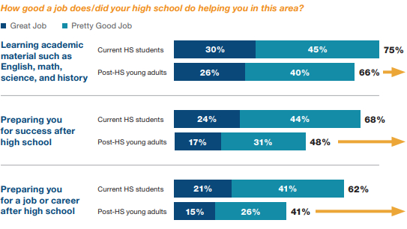
Students value SEL
Recent high school graduates see significant deficits in high schools preparing for life after school.
Source: Respected: Perspectives of Youth on High School & Social and Emotional Learning (2018)
Notes:
In terms of how well their high school prepares students for success after high school: 68 percent of current high school students believe their school is doing a good job of preparing them for success after high school; less than half of former high school students (48 percent) agree.
In terms of how well their high school does at preparing students for a job or career: More than half (62 percent) of current high school students think their high school is doing a good job preparing them for a job or career. Once again, most young adults out of high school disagree.

Slide 21


Teachers are asking for more support
22%
feel they are “very prepared” to teach SEL
report that the level of SEL professional development
offered at their school is not sufficient
Teachers view parental support and engagement as the top factor that would help them be more effective when teaching SEL
51%
Source: 2018 Social and Emotional Learning report, 2018

Slide 22
Responding to the demand:
National Commission on Social, Emotional, and Academic Development
Our nation is truly at a turning point: We now understand that social and emotional development underpin children’s academic learning, growth, and success.
This understanding is fueling a growing movement of young people, educators, parents, researchers, leaders in business and civil rights and communities from across the country. Science has made clear that children learn best when we teach them as whole people, and schools and communities are recognizing that they can no longer separate academics and students’ broader development.
A Nation at Hope is the result of listening to the experiences and needs of young people, parents, teachers, school and district leaders, community leaders, and other experts.
The report and recommendations, states, communities, educators, and families now have evidence-based, expert-backed ways to foster every student’s social, emotional, and academic development
Notes:
The latest evidence of demand: a major national report from a blue-ribbon commission of educators, policymakers, civic and business leaders, parents, students, and scholars - http://nationathope.org/
The NCSEAD report comes FROM the nation and responds to this huge and growing demand

Slide 23






CASEL’s tools and resources:
Support high-quality SEL implementation
SEL District Resource Center
Resources from districts where SEL programs, practices, and policies are working to support high-quality SEL implementation.
https://drc.casel.org
Schoolwide Guide to SEL
Guidance for systemic SEL implementation in a school.
https://schoolguide.casel.org/
SEL State Resources
Sample policies and practices that support SEL.
https://casel.org/csi-resources/
SEL Assessment Guide
Guidance to choose and use an SEL assessment.
http://measuringsel.casel.org/assessment-guide/
Program Review Guides
Recommendations for selecting high-quality SEL programs.
https://casel.org/guide/
SEL Starts at Home
Resources to bring SEL into your home and community.
https://casel.org/in-the-home/
Notes:
Our suite of tools are field-vetted and evidence-based aimed at higher-quality implementation nationwide.

